Slide 1
Multı-threadıng with python
Recep YILDIRIM – recep.yildirim@sabanciuniv.edu
CS408 – Computer Networks

Slide 2
Contents
What is a Thread
Daemon Threads
Joining Threads
Race Conditions
Basic Synchronization
Deadlock
CS408 – Computer Networks

Slide 3

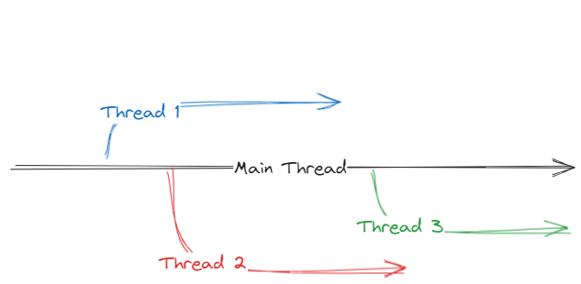
What ıs a thread
A separate flow of execution
Two things happening at once
Similar to multiprocessing (but not same)
See code example…
CS408 – Computer Networks

Slide 4
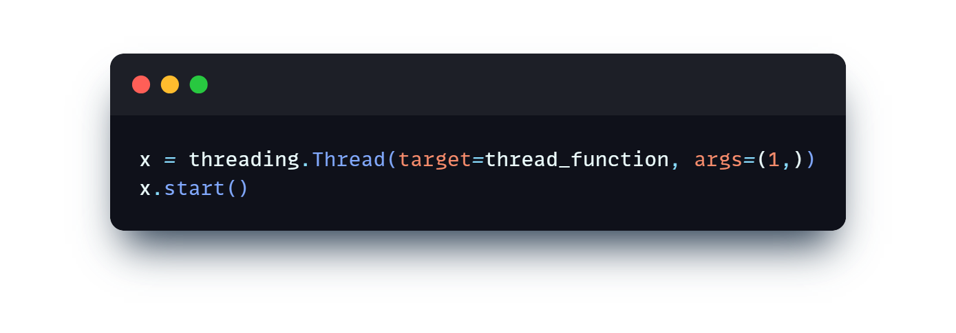
Basıc thread
CS408 – Computer Networks

Slide 5

Daemon Threads
A daemon is a process that runs in the background.
A daemon thread will shut down immediately when the program exits
Or program will wait the threads to complete
CS408 – Computer Networks

Slide 6
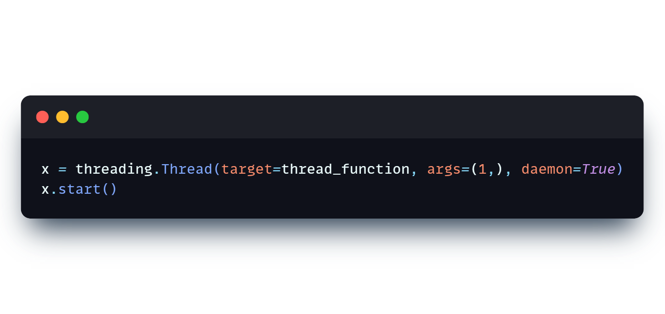
Daemon thread
CS408 – Computer Networks

Slide 7
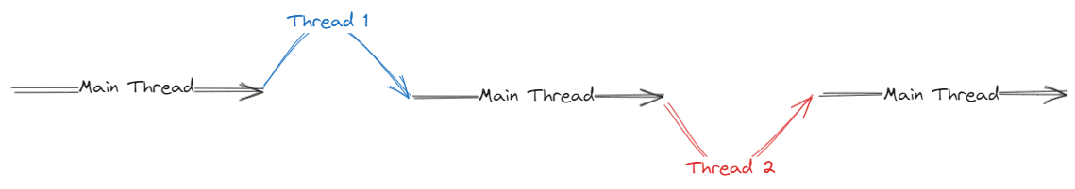
Joınıng threads
Threads run independently
Python has a Main Thread
Joining means waiting a thread to complete
Blocks the main thread
See code example…
CS408 – Computer Networks

Slide 8

Joınıng threads
This may also be the case
See code example…
CS408 – Computer Networks

Slide 9

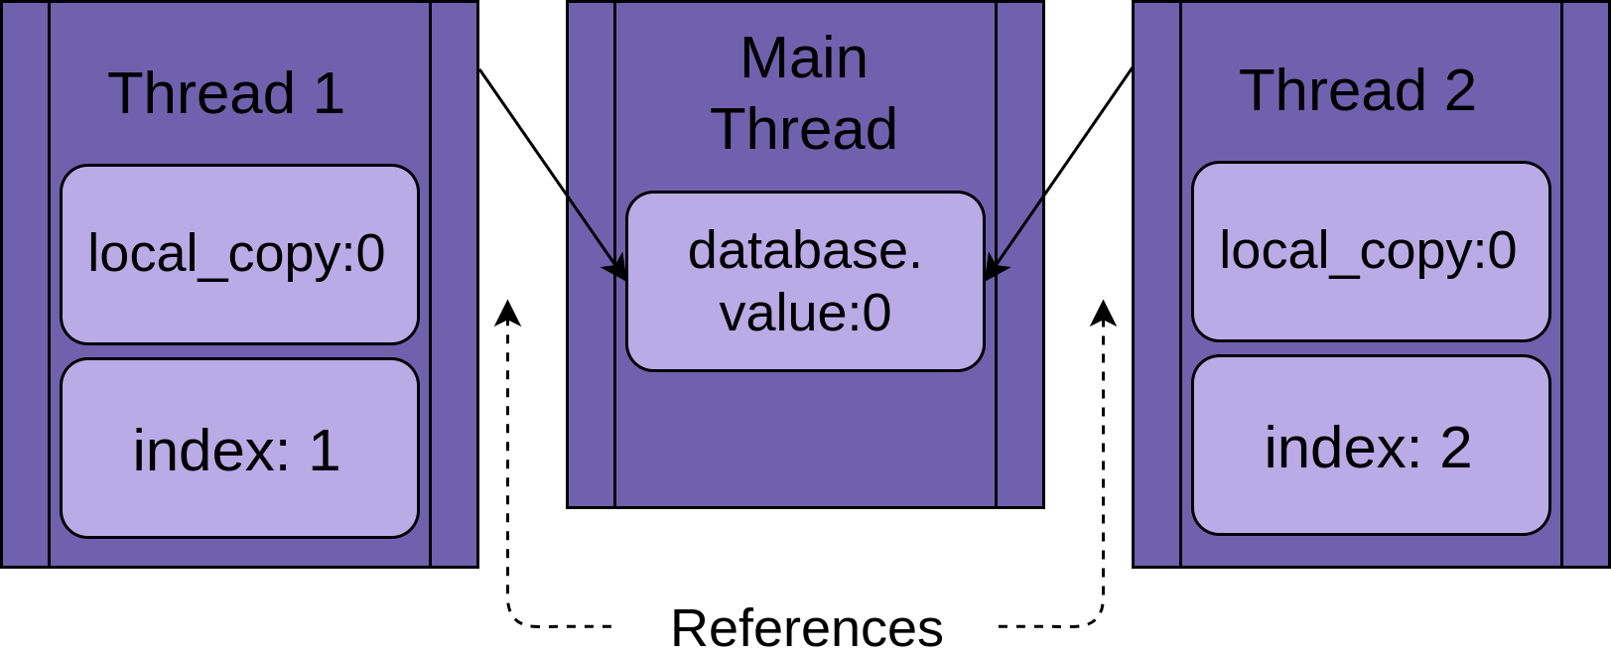
Race Conditıons
A daemon thread will shut down immediately when the program exits
May occur when two or more threads access a shared piece of data
CS408 – Computer Networks

Slide 10
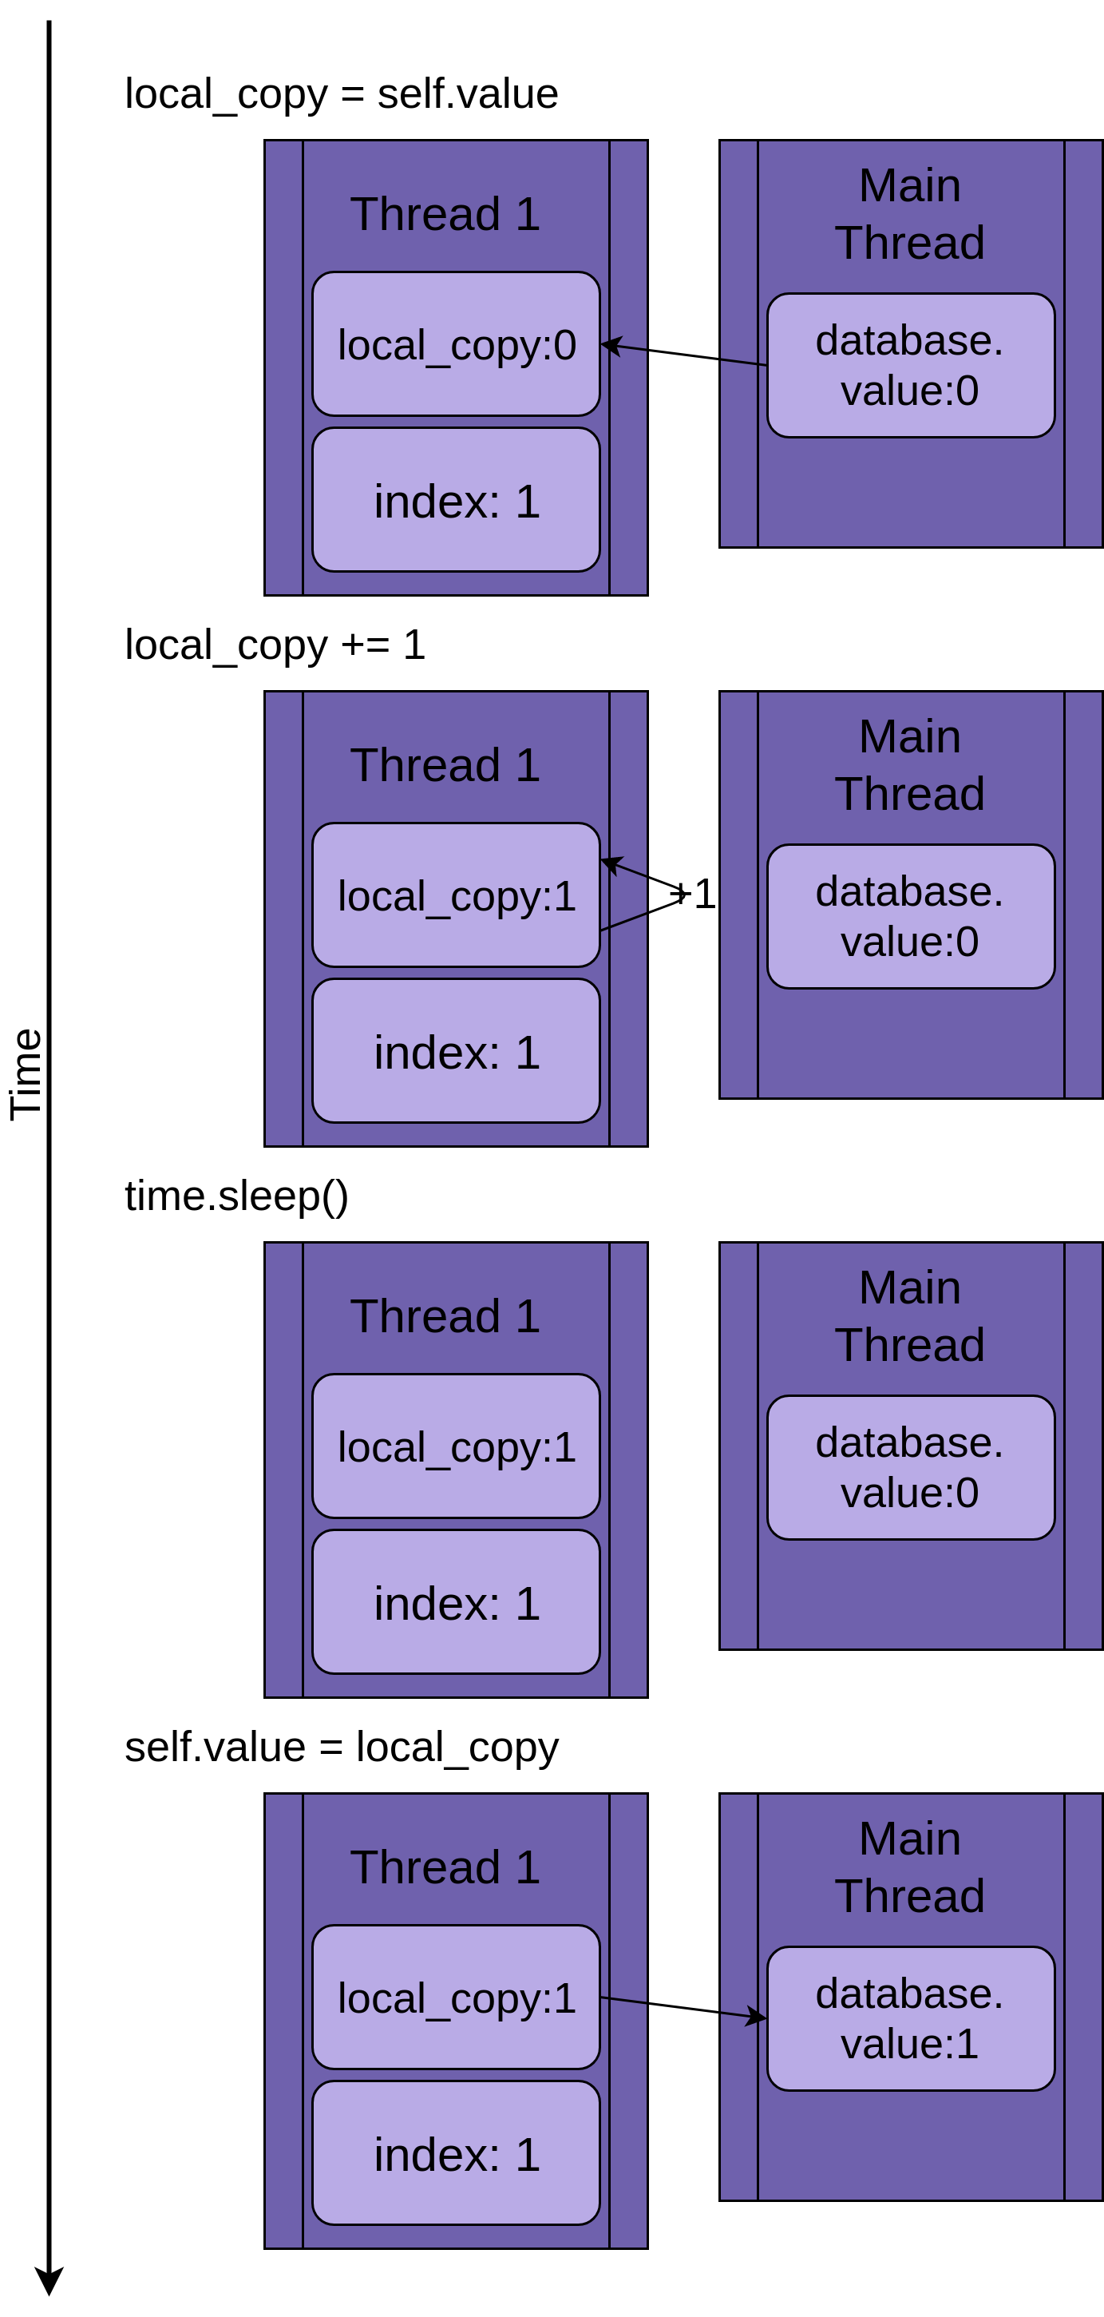
Race Conditıons
With one thread everything works as expected
CS408 – Computer Networks

Slide 11

What ıf
we had two threads working simultaneously on the same data?
CS408 – Computer Networks

Slide 12
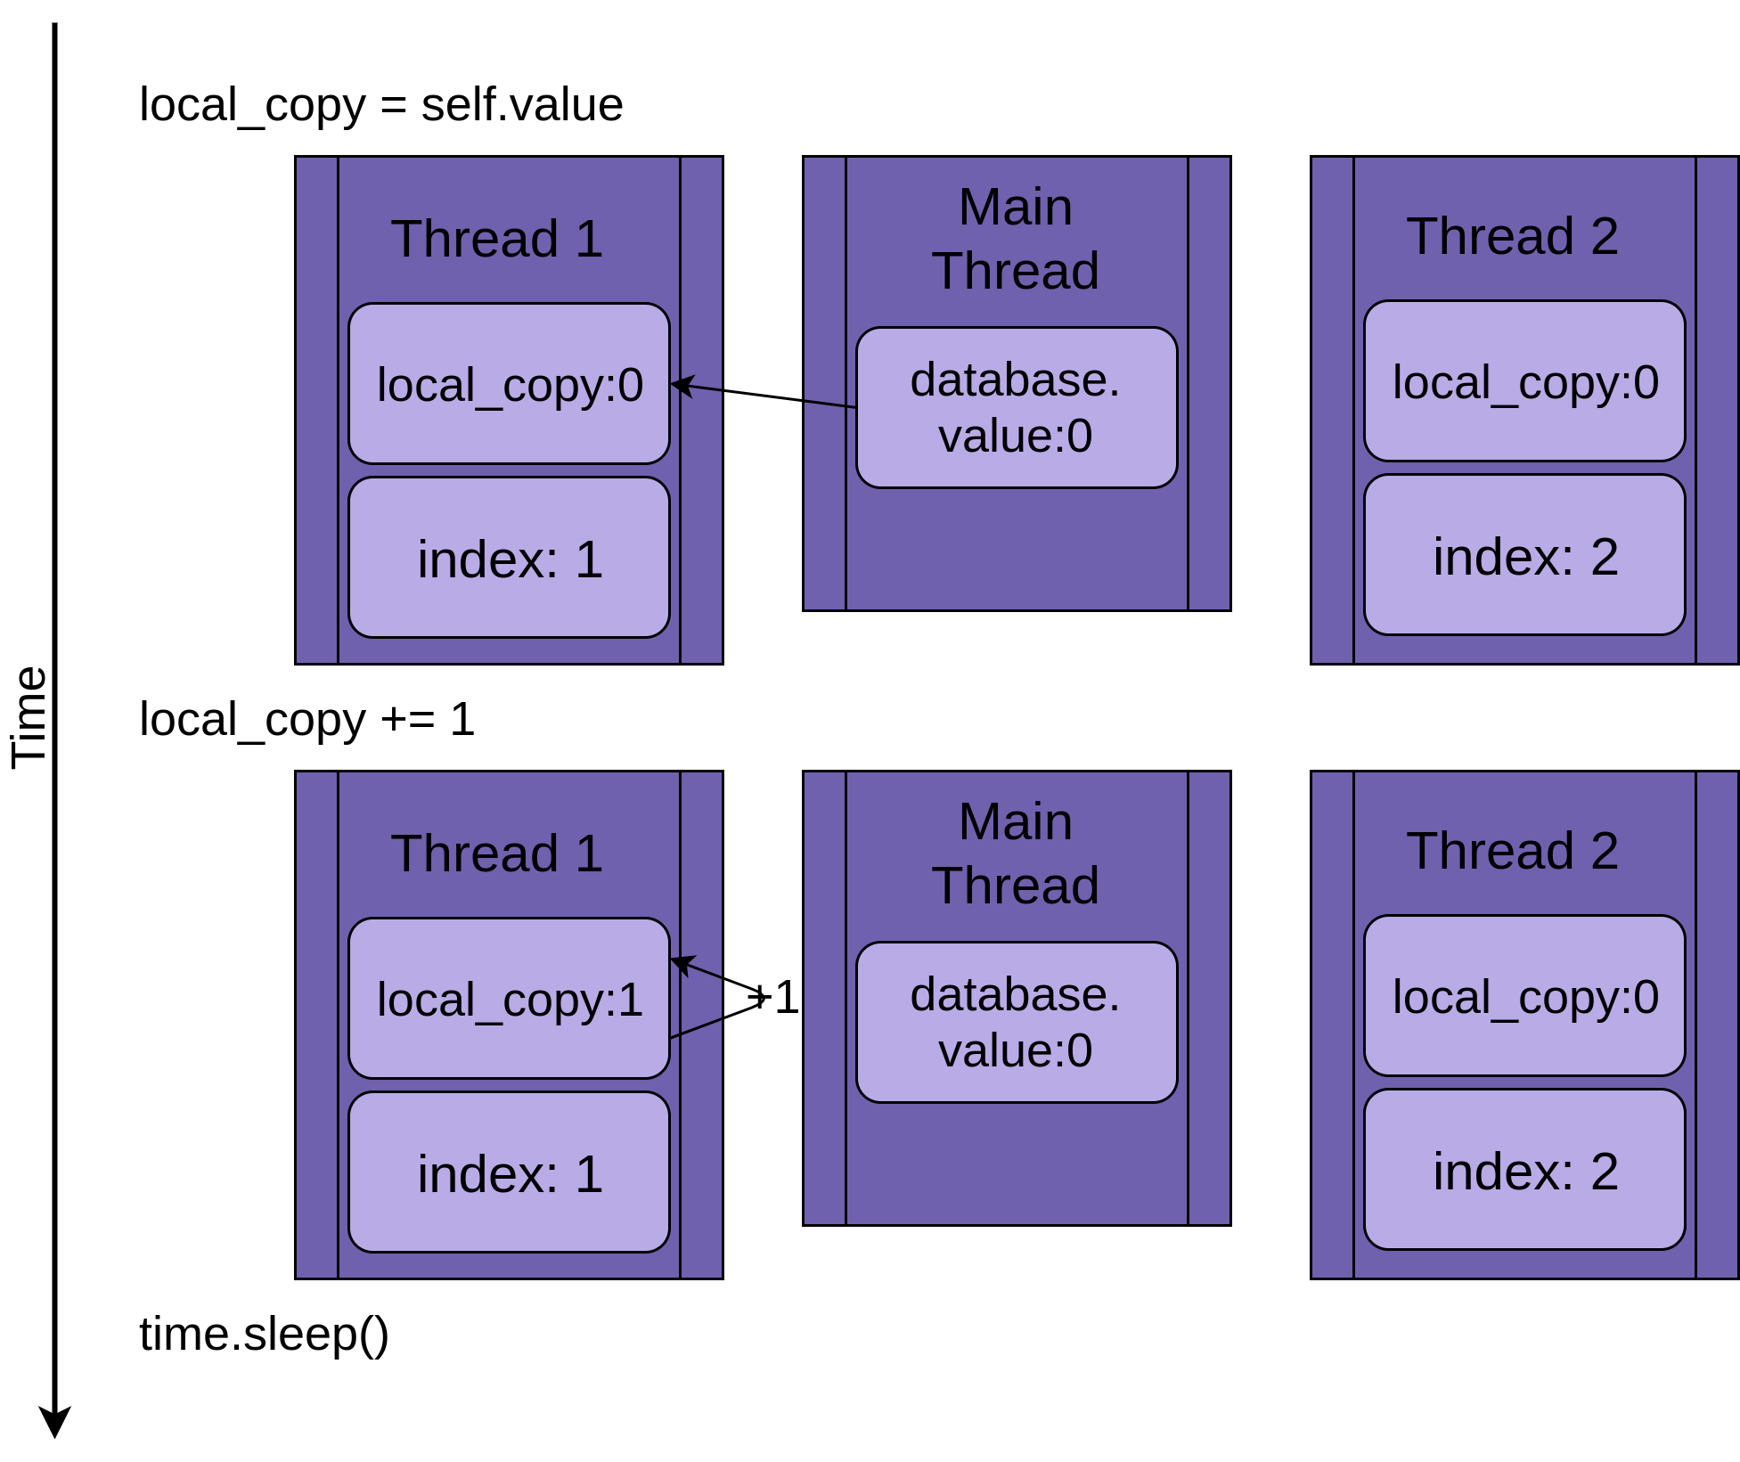
CS408 – Computer Networks

Slide 13
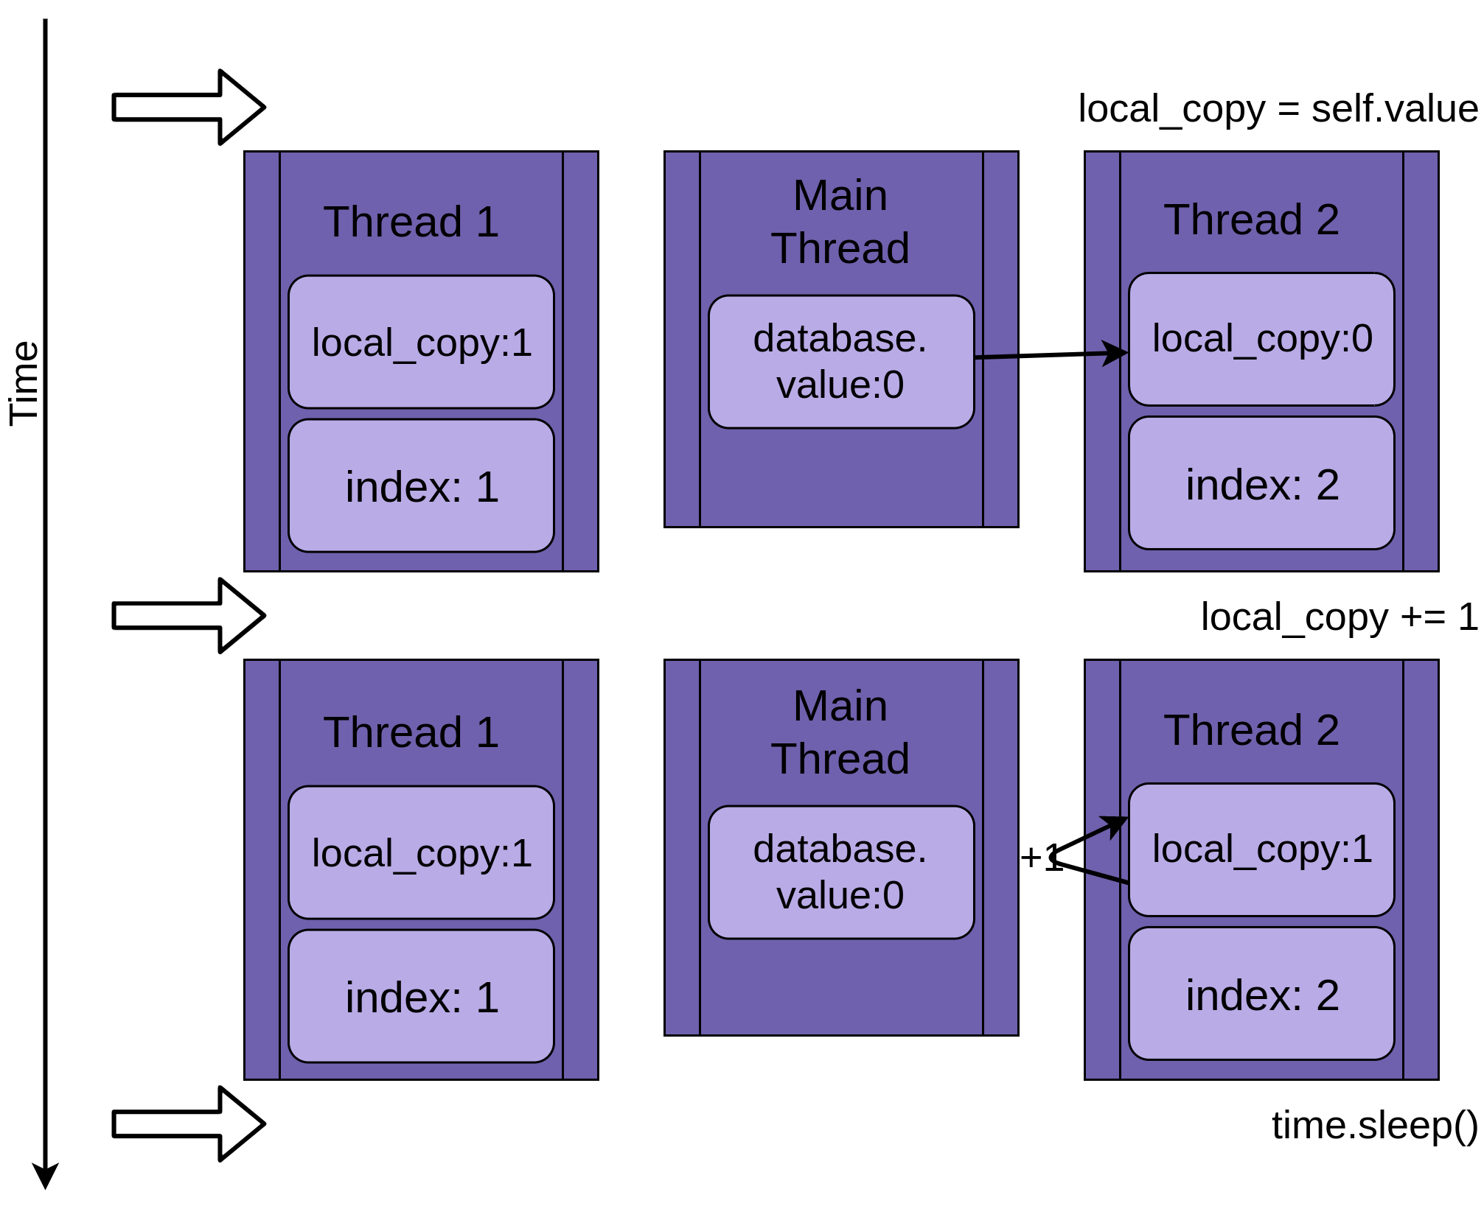
CS408 – Computer Networks

Slide 14
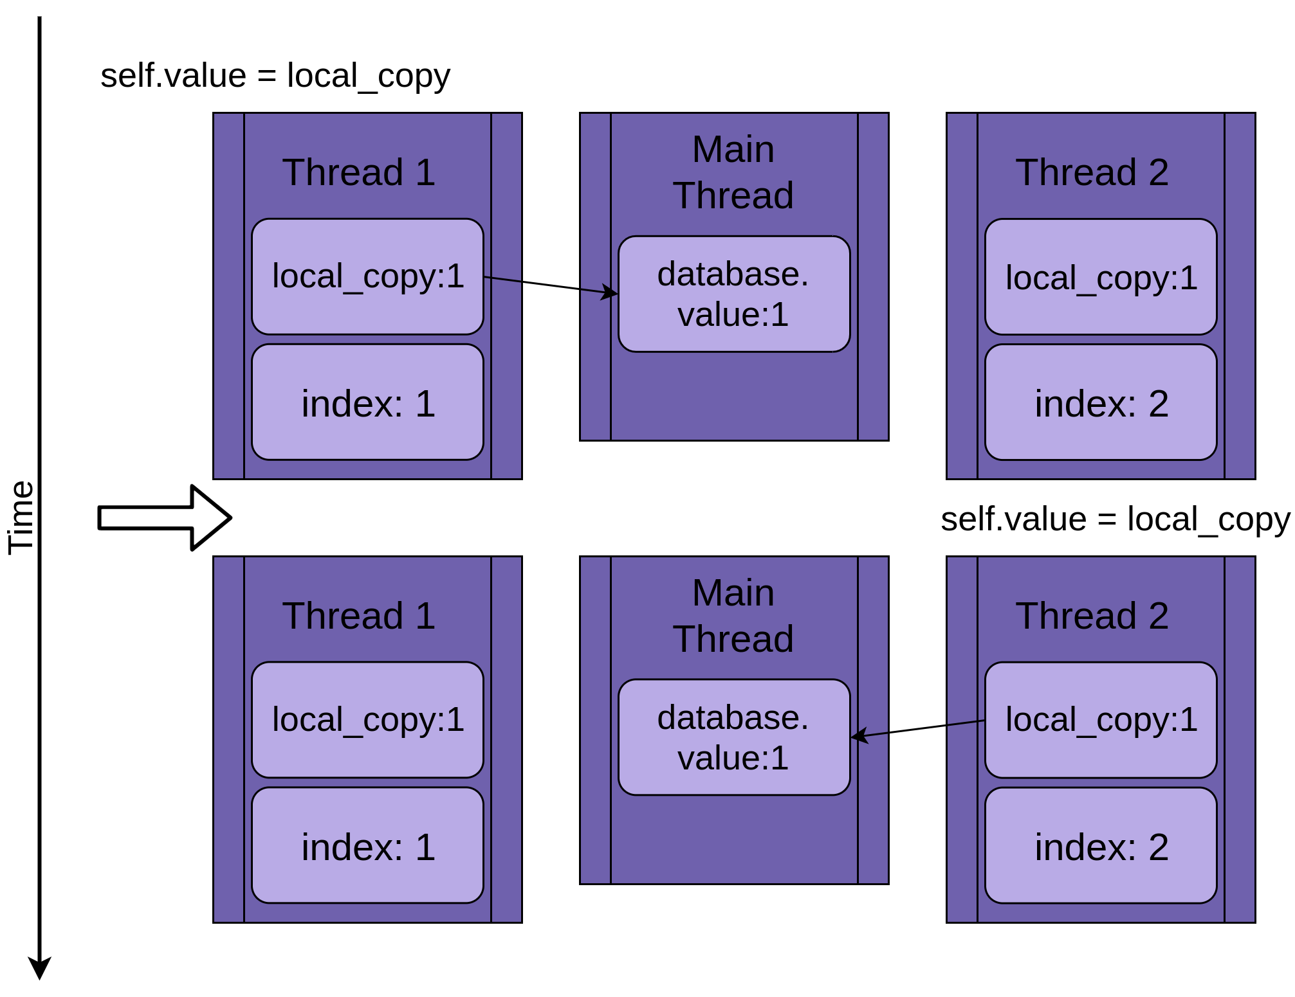
CS408 – Computer Networks

Slide 15

Basic Synchronization Using Lock
Blocks all threads until the thread which holds lock completes its tasks
Also called Mutex
It can be acquired and released by threads
CS408 – Computer Networks

Slide 16

Do not handle
key acquiring
And release
manually
Deadlock
CS408 – Computer Networks

Slide 17

Questions?
CS408 – Computer Networks

